Slide 1
Tibet

Slide 2
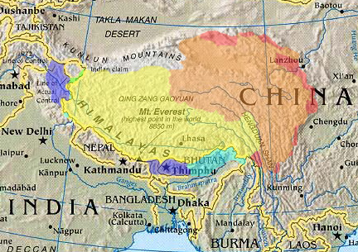
Geography – Tibet in Yellow

Slide 3
Geography: Tibet is isolated behind the great Himalayas covering vast high land areas with many mountains and valleys

Slide 4
The cuisine can be influenced by China, Nepal and India

Slide 5
History
The culture is not uniform and has been in danger of being lost.
Tibetans living outside of the country, are under the guidance the Dalia Lama, since the invasion of Tibet by the People's Republic of China in 1950

Slide 6
Tibet

Slide 7
Tibet
Muslim-style Beef Momo

Slide 8
Tibet
Yak lunch with Tibetan Monks
Kyle & Dan's Travels
a real traveler from London

Slide 9
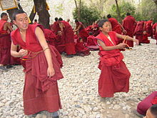
Religions and Ethnic Diversity
Buddhism

Slide 10
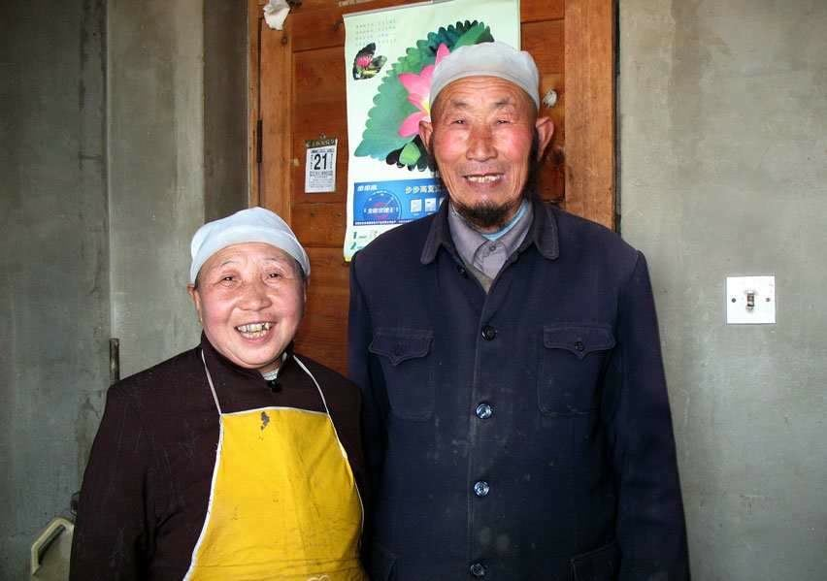
Religions
Tibetan Muslim

Slide 11
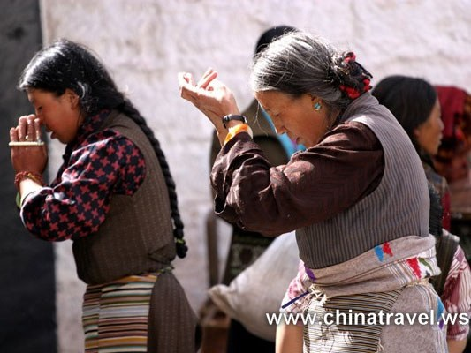
Religions
Bon

Slide 12
Culinary Etiquette
Dining custom
Foods
Host and guests are seated in certain positions, they pick up food from the table placed them in front and eat them separately.
The old generation does not eat fish because their Buddhist beliefs refuse killing creature. Moreover, fish is a symbol of a dragon or river god which is holy for Tibetan people.
Tibetan cuisine includes dried meat, cheese cake, caked, ginseng fruit cake, fried yak meat, sausage, stewed mutton, lamb’s head stew to name a few. Staple food includes: butter, zanba (roasted barley, yak butter and water), steamed cake with cheese, steamed cake, and of course dumplings and noodles.

Slide 13
Prevailing Flavors
Ingredients
Fruits
Grains
Very little meat because Buddhism does not allow taking he life of another.
Meat is for the sake of survival.
Slaughtering animals from their herds, their way of life is still religiously respectable. Even monks and nuns, welcome the dairy and meat products that the nomads provide.
Very little fruits or vegetable can grow in Tibet, due to the cold and dry climate many places.
Most of the people still live on yaks and sheep for their products. Where nothing but grass grows, the people are nomads who tend animals. They trade their animal products to farmers for dried vegetable, grains, flour, spices and other necessities.

Slide 14
Ingredients
Barley and Wheat Harvest

Slide 15
Ingredients
Lhasa Open Market

